Slide 1
Data Structures, Algorithms and Design

Slide 2
Contact Session I

Slide 3
Plan of Lecture
Introduction to the Course
Introduction to the Algorithms
Introduction to the Basic Data Structures

Slide 4
Course Introduction
COURSE DESCRIPTION:
The course covers design, implementation and applications of data structures including trees and graphs. The course covers algorithm design techniques using examples from sorting, searching, graph theory, networking and number theory.
The scope of the designs will include complexity issues and suitability issues.

Slide 5
Course Objectives
CO1 | Introduce mathematical and experimental techniques to analyze algorithms
CO2 | Introduce linear and non-linear data structures and best practices to choose appropriate data structure for a given application
CO3 | Teach various dictionary data structures (Lists, Trees, Heaps) with illustrations on possible representation, various operations and their efficiency
CO4 | Exposes students to various sorting and searching techniques
CO5 | Discuss in detail various algorithm design approaches (Greedy method, divide and conquer, dynamic programming, backtracking, and branch and bound) with appropriate examples, methods to make correct design choice and the efficiency concerns.
CO6 | Introduce complexity classes , notion of NP-Completeness, ways of classifying problem into appropriate complexity class
CO7 | Introduce reduction method to prove a problem’s complexity class.

Slide 6
TEXT BOOK (T):
Algorithms Design: Foundations, Analysis and Internet Examples, by Michael T. Goodrich, Roberto Tamassia, 2006, Wiley (Students Edition)
REFERENCE BOOKS (R):
Data Structures, Algorithms and Applications in C++, Sartaj Sahni, Second Ed, 2005, Universities Press
Cormen T.H., Leiserson, C.E., Rivest, R.L., and C. Stein. Introduction to Algorithms, MIT Press, Second Edition (Indian reprint: Prentice-Hall).

Slide 7
Learning Outcomes
LO1 | Describe various fundamental data structures, their properties, algorithm design techniques and various means of evaluating algorithms
LO2 | Demonstrate the ability to evaluate algorithms, to select from a range of possible options, to provide justification for that selection, and to implement the algorithm in a particular context.
LO3 | Solve problems using Algorithms for Linear and Non-Linear Data Structures, Graph algorithms (Shortest Paths Algorithms, Connectivity and Reachability Algorithms, Spanning Trees)
LO4 | Explain with a practical example, each of the algorithm design strategies (brute-force, greedy, divide-and-conquer, recursive backtracking, and dynamic programming)
LO5 | Use brute-force, greedy, divide-and-conquer, recursive backtracking, and dynamic programming techniques to solve a given algorithm design problem.
LO6 | Relate the real-world problems to known data structures and algorithms leading to the recommend appropriate solutions in representation and implementation.
LO7 | Explain the significance of NP-completeness
LO8 | Classify problems into complexity classes P and NP and to prove hardness of problems

Slide 8
EVALUATION SCHEME
Evaluation Component | Name (Quiz, Lab, Project, Midterm exam, End semester exam, etc) | Type (Open book, Closed book, Online, etc.) | Weight | Duration | Day, Date, Session, Time
EC - 1 | Quiz-I/ Assignment-I | Online | 5% | - | September 10-20, 2020
 | Quiz-II | Online | 5% | - | October 20-30, 2020
 | Quiz-III/ Assignment-II | Online | 5% | - | November 10-20, 2020
EC - 2 | Mid-term Exam | Closed book | 35% | 2 hours | Saturday, 10/10/2020 (FN) 10 AM - 12 Noon
EC - 3 | End Semester Exam | Open book | 50% | 3 hours | Saturday, 28/11/2020 (FN) 9 AM – 12 Noon

Slide 10
Data Structures, Algorithms and Design
Module 1

Slide 11
ALGORITHM
A well-defined computational procedure that takes some value, or a set of values, as input and produces some value, or a set of values, as output.
It can also be defined as sequence of computational steps that transform the input into the output.

Slide 12
Algorithms and it’s Specification
All algorithms must satisfy the following criteria:
Input. There are zero or more quantities that are externally supplied.
Output. At least one quantity is produced.
Definiteness. Each instruction is clear and unambiguous.
Finiteness. If we trace out the instructions of an algorithm, then for all cases, the algorithm terminates after a finite number of steps.
Effectiveness. Every instruction must be basic enough to be carried out, in principle, by a person using only pencil and paper. It is not enough that each operation be definite as in (3); it also must be feasible.

Slide 13
Algorithms and it’s Specification
The specification is the process of conversion of solution into an algorithm.
Done in 3 ways:
Natural language
Flowchart
Pseudo Code

Slide 14
EFFICIENCY OF AN ALGORITHM
Complexity of algorithm is a function of size of input of a given problem instance which determines how much running time/memory space is needed by the algorithm in order to run to completion.
Time Complexity: Time complexity of an algorithm is the amount of time it needs in order to run to completion.
Space Complexity: Space Complexity of an algorithm is the amount of space it needs in order to run to completion.
There are two points which we should consider about computer programming:-
An appropriate data structure and
An appropriate algorithm.

Slide 15
EFFICIENCY OF AN ALGORITHM
It can be of various types:
Worst case efficiency: It is the maximum number of steps that an algorithm can take for any collection of data values.
Best case efficiency: It is the minimum number of steps that an algorithm can take any collection of data values.
Average case efficiency: It can be defined as
the efficiency averaged on all possible inputs
must assume a distribution of the input
We normally assume uniform distribution (all keys are equally probable)
If the input has size n, efficiency will be a function of n

Slide 16
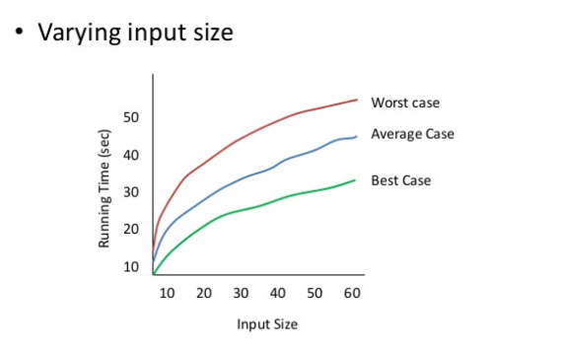
EFFICIENCY OF AN ALGORITHM

Slide 17
Examples
Average in increasing order of the occurrence of number (in ONE loop)
INPUT
OUTPUT
2 | 6 | 4 | 8 | 3 | 8 | 14 | 24 | 54 | 76 | 21 | 87 | 95 | 2 | 45
2 | 8 | 12 | 20 | 23 | 31 | 45 | 69 | 123 | 199 | 220 | 307 | 402 | 404 | 449

Slide 18
Use of Prefix average:
Prefix Averages
Given an array X storing n numbers
We want to compute an array A such that A[i] is the average of elements uptill “i”.
Application
Economics and statistics (year by year update)
“Smoothing" function for a parameter that is quickly changing

Slide 19
Example: Normal Way of solving
Algorithm prefixAveragesl(X):
Input: An n-element array X of numbers.
Output: An n-element array A of numbers such that A [i] is the average of elements X {0],. . . , X [i].
Let A be an array of n numbers.
For i ← 0 to n-1 do
a ← 0
For j ← 0 to i do
a ← a+X[j]
A[i] ← a/(i+1)
return array A

Slide 20
Example: Normal Way of solving
Algorithm prefixAveragesl(X):
Input: An n-element array X of numbers.
Output: An n-element array A of numbers such that A [i] is the average of elements X {0],. . . , X [i].
Let A be an array of n numbers.
For i ← 0 to n-1 do
a ← 0
For j ← 0 to i do
a ← a+X[j] executes 1+2+3+……n times→n(n+1)/2 times
A[i] ← a/(i+1)
return array A So the running time is O(n²)

Slide 21
Example: Better Way of solving
Algorithm prefixAveragesl(X):
Input: An n-element array X of numbers.
Output: An n-element array A of numbers such that A [i] is the average of elements X {0],. . . , X [i].
Let A be an array of n numbers.
For i ← 0 to n-1 do
a ← 0
For j ← 0 to i do
a ← a+X[j]
A[i] ← a/(i+1)
return array A
calculate the sum every time increase complexity
We need to get rid of the loop

Slide 22
Example: Better Way of solving
Algorithm prefixAverages_lI(X):
Input: An n-element array X of numbers.
Output: An n-element array A of numbers such that A [i] is the average of elements X {0],. . . , X [i].
Let A be an array of n numbers.
For i ← 0 to n-1 do
s←s+X[i]
A[i] ←s/(i+1)
return array A

Slide 23
Some More Examples:
To find the Max/Min element for the:
Sorted Array
Unsorted Array
To find the Second Max/Min element for the:
Sorted Array
Unsorted Array
To find the Third Max/Min element for the:
Sorted Array
Unsorted Array
2 | 6 | 4 | 8 | 3 | 8 | 14 | 24 | 54 | 76 | 21 | 87 | 95 | 2 | 45

Slide 24
Some More Examples:
To find the Max/Min element for the:
Want to travers only half a list. (can also be used for top 2)
Using two pointers & traversing with the jump of 1.
Want to travers only one-third of the list. (can also be used for top 3)
Using three pointers & traversing with the jump of 2.
…….
2 | 6 | 4 | 8 | 3 | 8 | 14 | 24 | 54 | 76 | 21 | 87 | 95 | 2 | 45

Slide 25
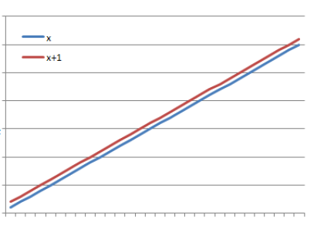
ASYMPTOTIC NOTATIONS
Asymptotic
It means a line that continually approaches a given curve but does not meet it at any finite distance.
Example
(x) is asymptotic with (x + 1) as shown in graph.

Slide 26
ASYMPTOTIC NOTATIONS
Asymptotic may also be defined as a way to describe the behaviour of functions in the limit or without bounds.
Let f(x) and g(x) be two functions of real numbers.
We say that f and g are asymptotic and write f(x) ≈ g(x) if

Slide 27
Thank You

